Slide 1
LL3 Section 123
General theory of elastic scattering

Slide 2














































Slide 3


































Slide 4




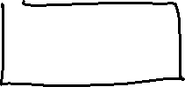







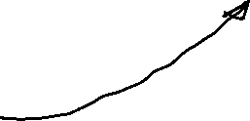



Slide 5





























Free
particle

Slide 6












































Slide 7
































Slide 8

































Slide 9



















Slide 10



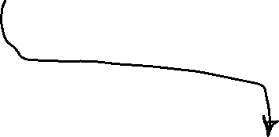















Slide 12








Slide 13








Slide 14











Slide 15



















Slide 16

















Slide 17
























Slide 18








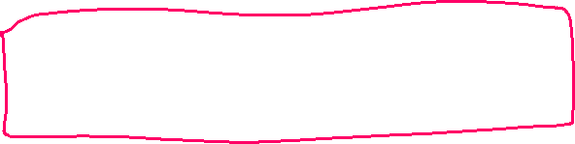











Slide 19











































Slide 20







